Slide 1

Meet the Year 3 Team!
8.9.26

Slide 2
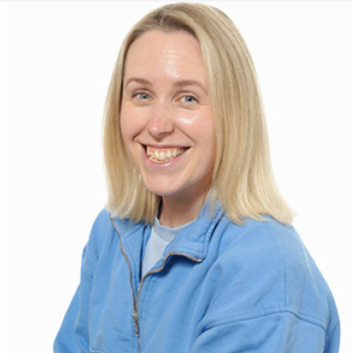
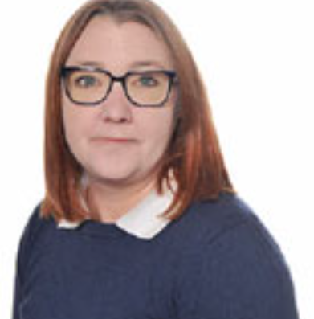
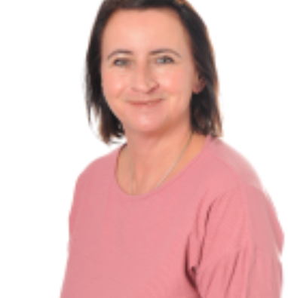
Our Team
Miss Cross Mrs Forsyth Mrs Rogers
Class teacher Teaching assistant Teaching assistant

Slide 3
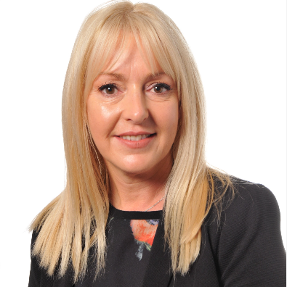
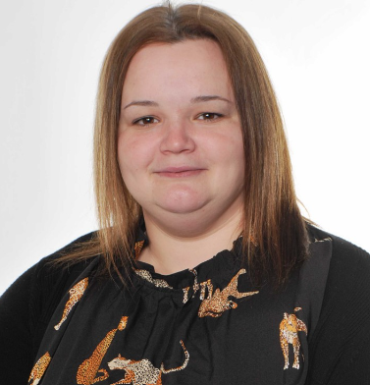
Our Team
Mrs Beddow Miss Tyler
Class Teacher (Thursdays) Teaching assistant

Slide 4

Our School Rules and Values

Slide 5
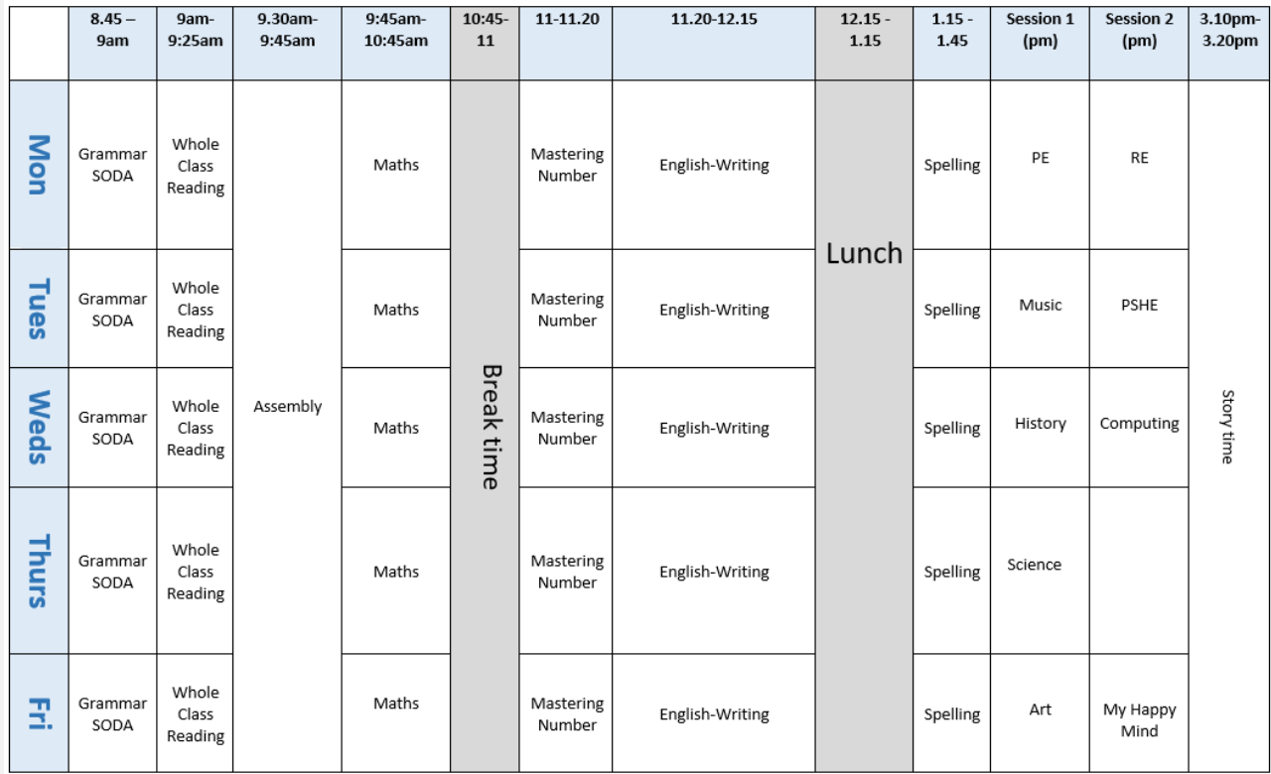
Our week

Slide 6
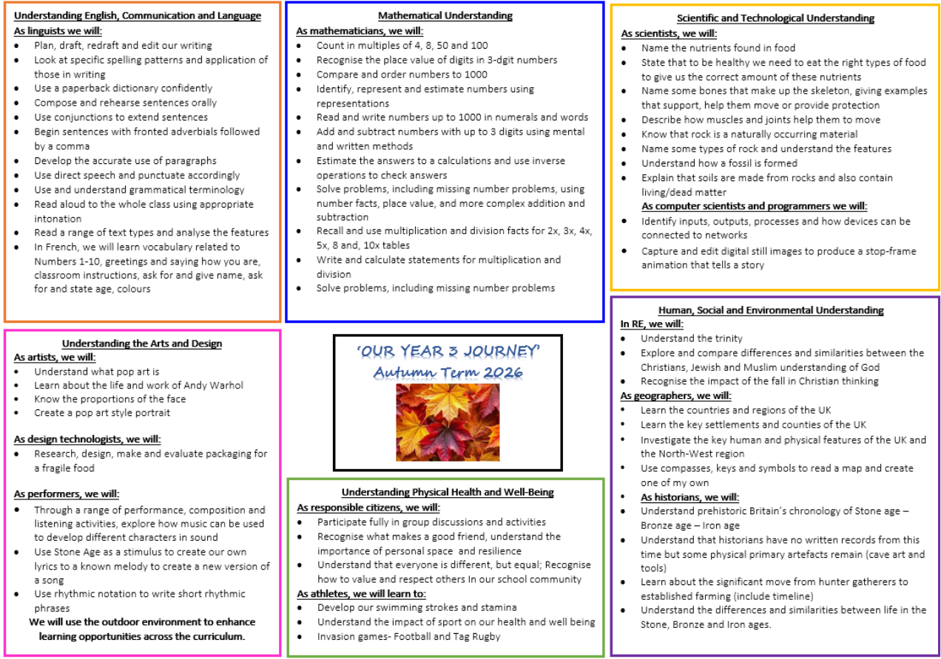
What we'll cover this term

Slide 7

National Curriculum Expectations
We assess formally 3 times a year in English and Maths using NFER. This helps to see if your child is working towards expectations, age related or working at greater depth. (WT, ARE, GD) It also helps us to see where interventions are required to fill any gaps in learning.

Slide 8
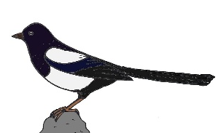
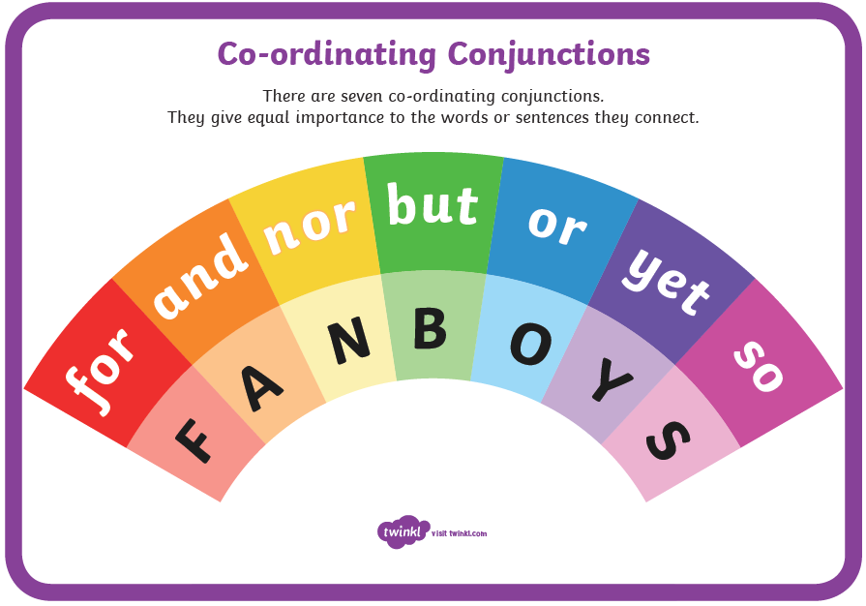
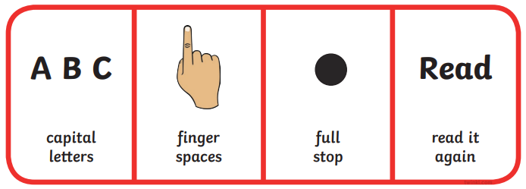





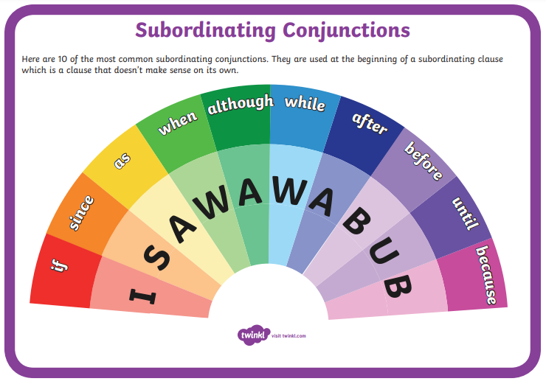
Y3 ARE writing needs:
legible handwriting of consistent size and spacing and evidence of joins
accurate spelling of Y3/4 words, and use of prefixes and suffixes
coherent sentences with accurate punctuation and consistent tenses
a clear beginning, middle and end to stories
paragraphs to show group related ideas
heading and subheadings to aid presentation
description of characters and settings – using adjectives and adverbs
joining of ideas through a range of conjunctions
punctuation of direct speech with inverted commas
nouns

Slide 9
Reading in Year 3
All children placed into a reading group. Some will read daily, others x3 a week
Reading books – colour bands that match to their reading fluency level (how many words per minute) and a reading for pleasure book will be sent home
Keep reading every day – read to them, listen to them read
Encourage fiction, non-fiction, comics, magazines
Reading widely will really build their vocabulary, knowledge and foster a love of reading
We have story time at the end of every day (my favourite part of the day!)

Slide 10

Reading in Year 3

Slide 11
Key maths skills and vocabulary in Year 3
Addition Add numbers with 3 digits: +, add, more, addition plus, make, sum, total , altogether, double, near double, one more…, two more… ten more…, 100 more…greater, more, units, ones, tens, count, count (up) to count on (from, to) how many…? Hundreds boundary. | Subtraction Subtract numbers with 3 digits: -, subtract, take (away), minus leave, how many are left/left over? ten less… one hundred less , how many fewer is… than …? how much less is…? difference between, half, halve , =, equals, sign, is the same as , tens boundary, hundreds boundary, inverse
Multiplication Multiply 2-digits by a single digit number and solve problems for multiplication within the multiplication tables (3, 4 & 8 – ensure rapid recall): lots of, groups of , x, times, multiplication, multiply, multiplied by, multiple of, product, once, twice, three times, four, times, five times… ten times… , times as (big, long, wide and so on) , repeated addition, array, row, column | Division Divide 2-digit numbers by a single digit (where there is no remainder in the final answer): double, halve , share, share equally , one each, two each, three each… group in pairs, threes… tens , equal groups of , ÷, divide, division, divided by, divided into, left, left over, remainder

Slide 12

The ARE in maths is to know their 2s, 3s, 4s, 5s, 8s and 10 times tables.
All four ways need to fluent, e.g.
4 x 8 = 32
8 x 4 = 32
32 ÷ 4 = 8
32 ÷ 8 = 4
Regular practise on TTRS is needed and tables will be set based on ability. There is a national screen of tables in Y4 where the children answer questions on an ipad in under 6 seconds.

Slide 13
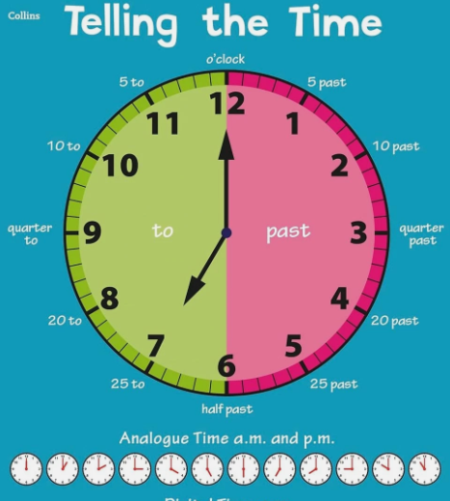
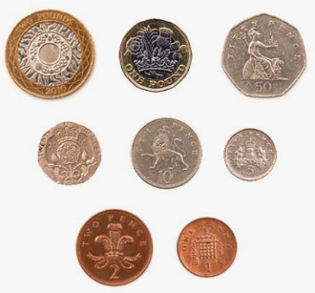
Other areas of maths to support at home:
Covered in the Summer term – Measurement block of White Rose
Ensure half past, o’clock and then quarter past and quarter to is secure, then we link to digital
Analogue clocks at home are a real help!
Money – covered in Summer term
Let them pay in shops, work out totals, estimate costs, calculate change
It’s valuable to let them see coins and notes in real life

Slide 14
Communication
Key dates – school website. Please subscribe to the calendar here: https://www.pikemereschool.com/calendar/?calid=1&pid=7&viewid=1
Newsletter (every other Friday)
Class Dojo – weekly update with what's happened during the week
Letters via SchoolComms about trips, visits and exciting activities
Other general information (policies, staffing, school lunches) can be found on our school website.
Teachers are on the door every morning – quick messages can be passed on there. Please email anything more detailed.
If you need a more detailed chat, we're happy to arrange a phone call or meeting.

Slide 15


Class Dojo
When children demonstrate one of our school values, they will receive a dojo.
Throughout the year, dojos will then build up to different milestones:
25 dojos – certificate
50 dojos – bronze badge
100 dojos – silver badge
150 dojos – gold badge
Badges will be given out during Star of the Week assembly on Friday

Slide 16



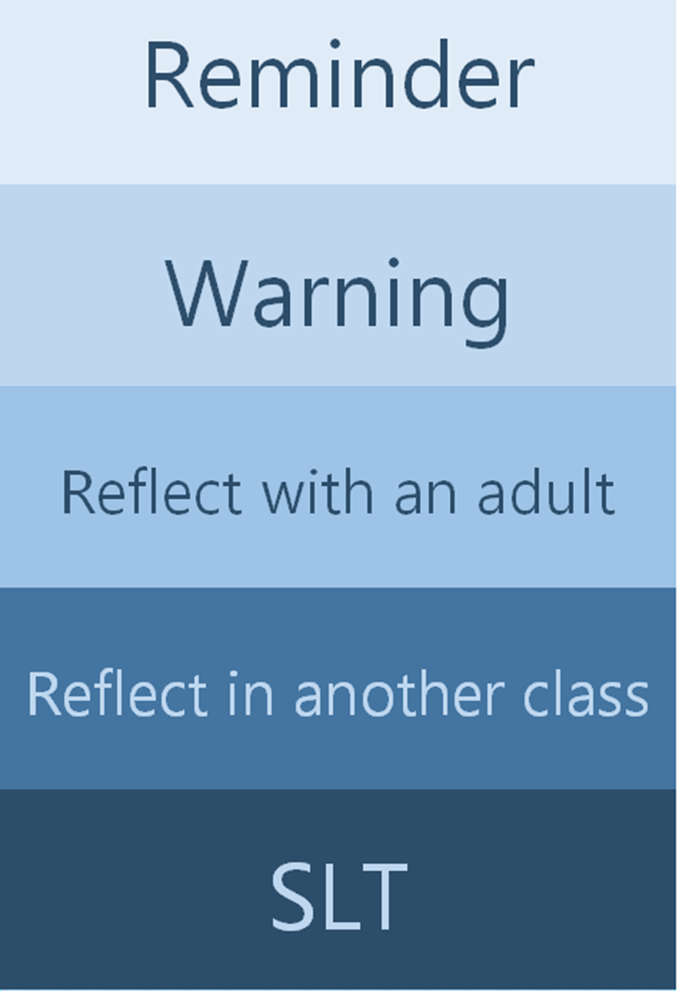
Our School Rules
We inform parents if children reach any of these stages

Slide 17
Homework
Your child will receive their homework book this week.
Each week, a piece from each book will be set as homework to consolidate learning in class.
Homework will be set each Friday to be submitted by the following Wednesday so that it can be marked before the next pieces are set.
If your child has any misunderstandings from their homework, we will address this with them in school and possibly send additional practice home if appropriate.

Slide 18
Things to look forward to in Year 3
We have a visitor experience day booked for October linked to the Stone Age
Working with Alsager Urban Wildlife on community projects
Visit to Manchester Museum – Egyptians topic
More responsibility – reading ambassadors, school council
Visit in school from a Cheshire beekeeper
Spring term geography fieldwork in Alsager
More opportunities to represent Pikemere at sporting events

Slide 19
Attendance
Every day matters.
If children aren't in school, we can't teach them.
Missing work to be sent home to complete in order to avoid gaps in learning.

Slide 20

Any questions?

