Slide 1

Meet the Year 6 Team!
15.9.26

Slide 2
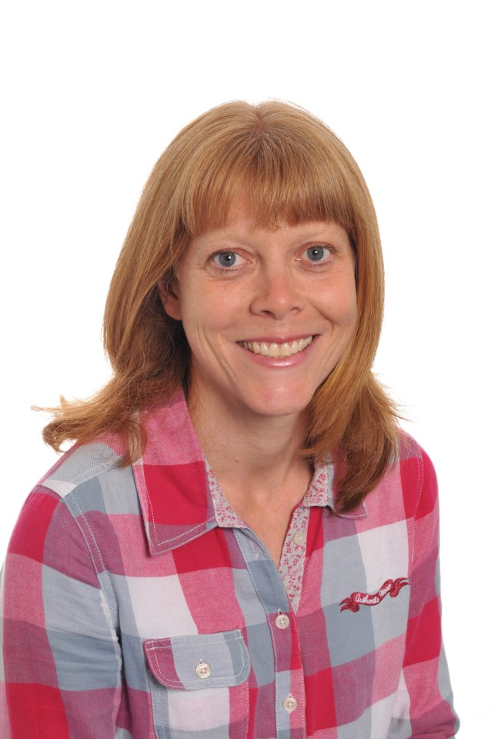
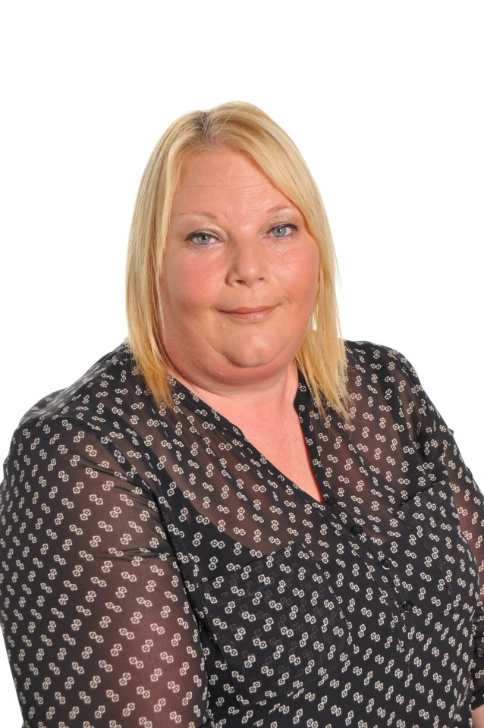
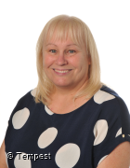
Our Team
Mrs Dodd Mrs Shortland Miss McNicholas
Class teacher Teaching assistant Teaching assistant

Slide 3

Our School Rules and Values

Slide 4
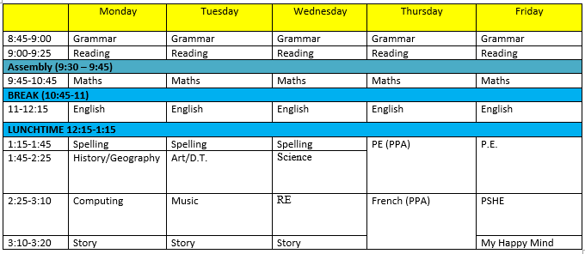
A typical week

Slide 5
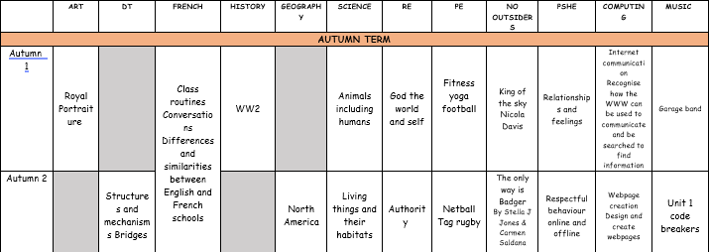
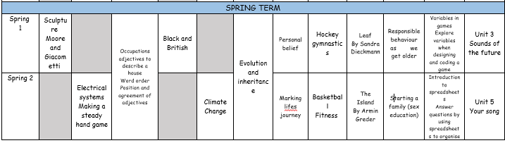
What we'll cover this year

Slide 6
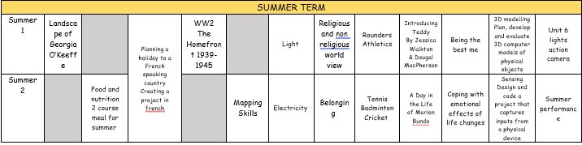

Slide 7
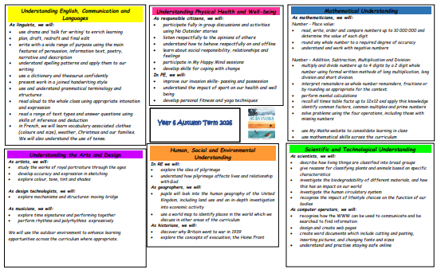
What we'll cover this term

Slide 8
Communication
Key dates – school website. Please subscribe to the calendar here: https://www.pikemereschool.com/calendar/?calid=1&pid=7&viewid=1
Newsletter (every other Friday)
Class Dojo – weekly update with what's happened during the week
Letters via SchoolComms about trips, visits and exciting activities
Other general information (policies, staffing, school lunches) can be found on our school website.
Teachers are on the door every morning – quick messages can be passed on there. Please email anything more detailed.
If you need a more detailed chat, we're happy to arrange a phone call or meeting.

Slide 9


Class Dojo
When children demonstrate one of our school values, they will receive a dojo.
Throughout the year, dojos will then build up to different milestones:
25 dojos – certificate
50 dojos – bronze badge
100 dojos – silver badge
150 dojos – gold badge
Badges will be given out during Star of the Week assembly on Friday

Slide 10



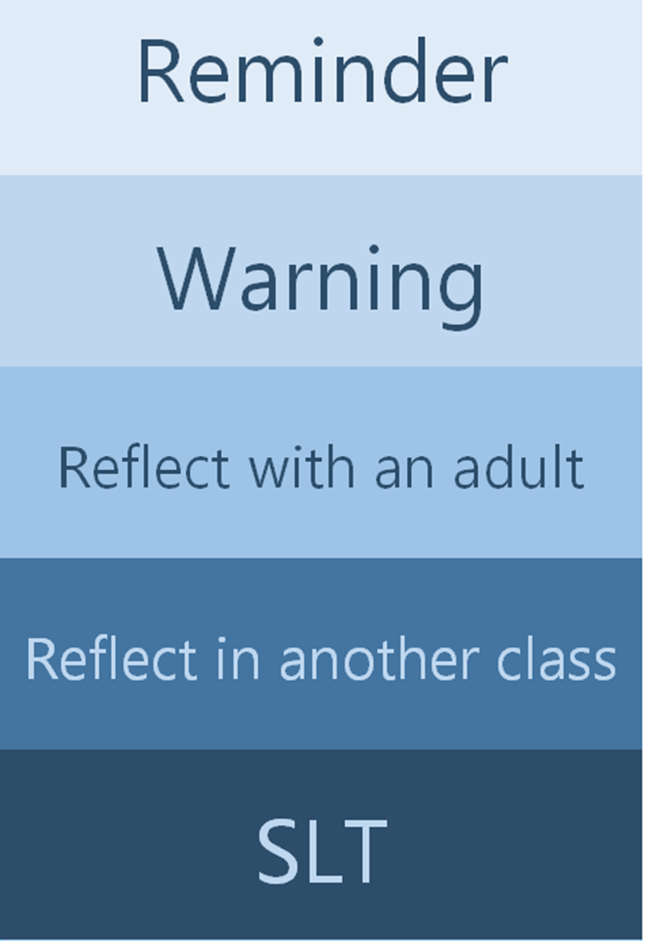
Our School Rules
We inform parents if children reach any of these stages

Slide 11
Homework
Your child will receive two homework books (one grammar and one maths).
Each week, a piece from each book will be set as homework to consolidate learning in class.
Homework will be set each Friday to be submitted by the following Wednesday so that it can be marked before the next pieces are set.
If your child has any misunderstandings from their homework, we will address this with them in school and possibly send additional practice home if appropriate.

Slide 12
Things to look forward to in Year 6
We already have two trips booked (Crucial Crew in October and the residential to RobinWood in January).
Forest Schools' sessions each term.
Responsibility in a wide range of jobs around school.
Buddy time!
A wide and varied curriculum.
A range of sporting opportunities.
SATs and KS2 production in the summer term.

Slide 13
Attendance
Every day matters.
If children aren't in school, we can't teach them.
Missing work to be sent home to complete in order to avoid gaps in learning.

Slide 14
Any questions?

