Slide 1

Meet the Year _ Team!
8.9.26

Slide 2
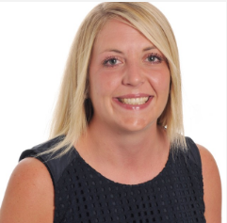
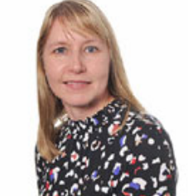
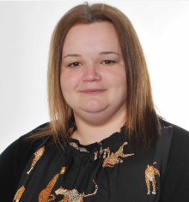
Our Team
Miss Smith – Class Teacher
Mrs Weetman- Teaching Assistant
Miss Tyler – Teaching Assistant

Slide 3

Our School Rules and Values

Slide 4
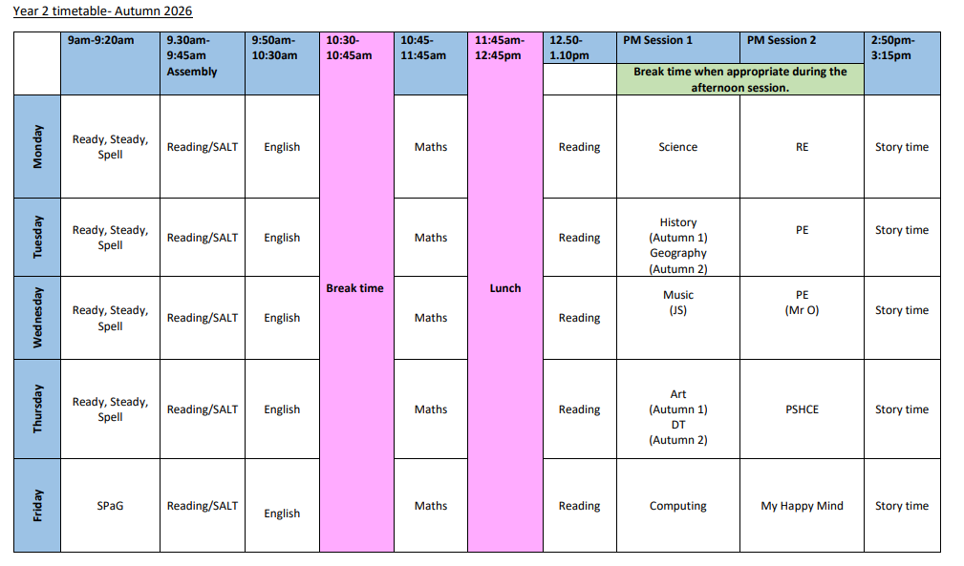
A typical week

Slide 5
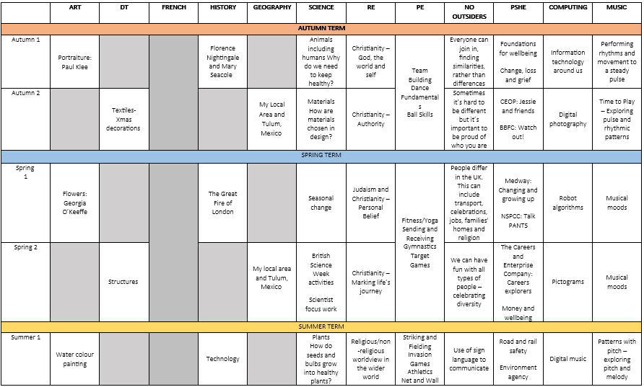

What we'll cover this year

Slide 6
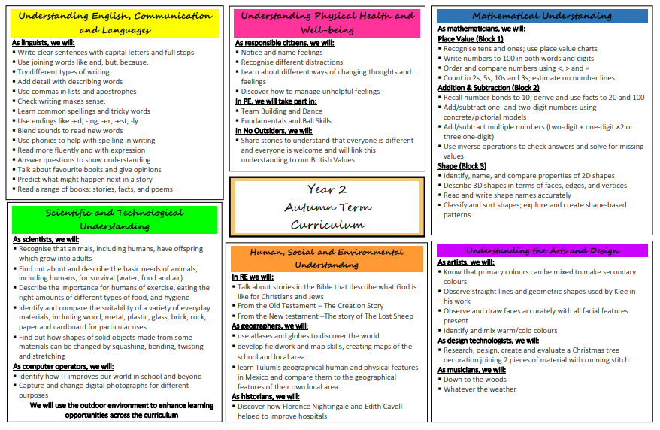
What we'll cover this term

Slide 7
Communication
Key dates – school website. Please subscribe to the calendar here: https://www.pikemereschool.com/calendar/?calid=1&pid=7&viewid=1
Newsletter (every other Friday)
Class Dojo – weekly update with what's happened during the week
Letters via SchoolComms about trips, visits and exciting activities
Other general information (policies, staffing, school lunches) can be found on our school website.
Teachers are on the door every morning – quick messages can be passed on there. Please email anything more detailed.
If you need a more detailed chat, we're happy to arrange a phone call or meeting.

Slide 8


Class Dojo
When children demonstrate one of our school values, they will receive a dojo.
Throughout the year, dojos will then build up to different milestones:
25 dojos – certificate
50 dojos – bronze badge
100 dojos – silver badge
150 dojos – gold badge
Badges will be given out during Star of the Week assembly on Friday

Slide 9



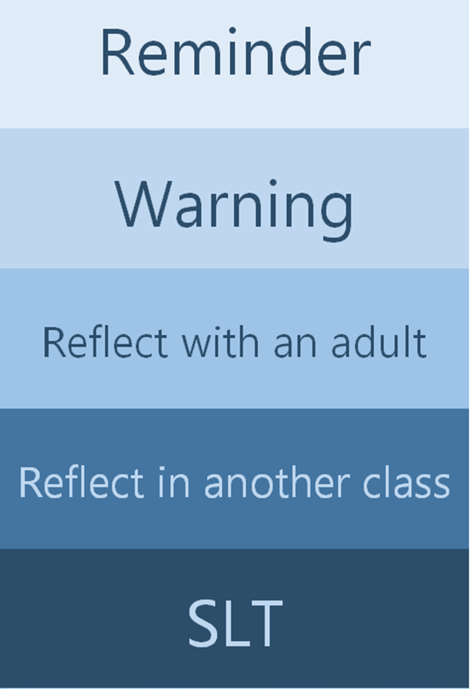
Our School Rules
We inform parents if children reach any of these stages

Slide 10
Homework
MyMaths Homework: Homework will be set each Wednesday and should be completed by the following Wednesday.
Reading: Two books will be sent home each week:
  A guided reading book linked to the week's learning.
  An independent banded book for additional reading practice at home.
  Please keep books and reading record in book bags all week.
  Read as often as possible
  Record when read at home
  1 dojo for every read

Slide 11
Things to look forward to in Year 2
Key Stage 1 Christmas Production- Year 2 Lead Roles
Theatre trip at Christmas
Visit to Nantwich Museum – Great Fire of London
Residential in May 2027
Sports activities at the High School lead by Sports Ambassadors
New Opportunities as they arise throughout the Year

Slide 12
Any questions?

